Slide 1
CODE Keynote
Andy Hargreaves
October 2020
Twitter: @hargreavesbc

Slide 2
There is light at the end of this tunnel.

Slide 3
But which way will we go then?

Slide 4
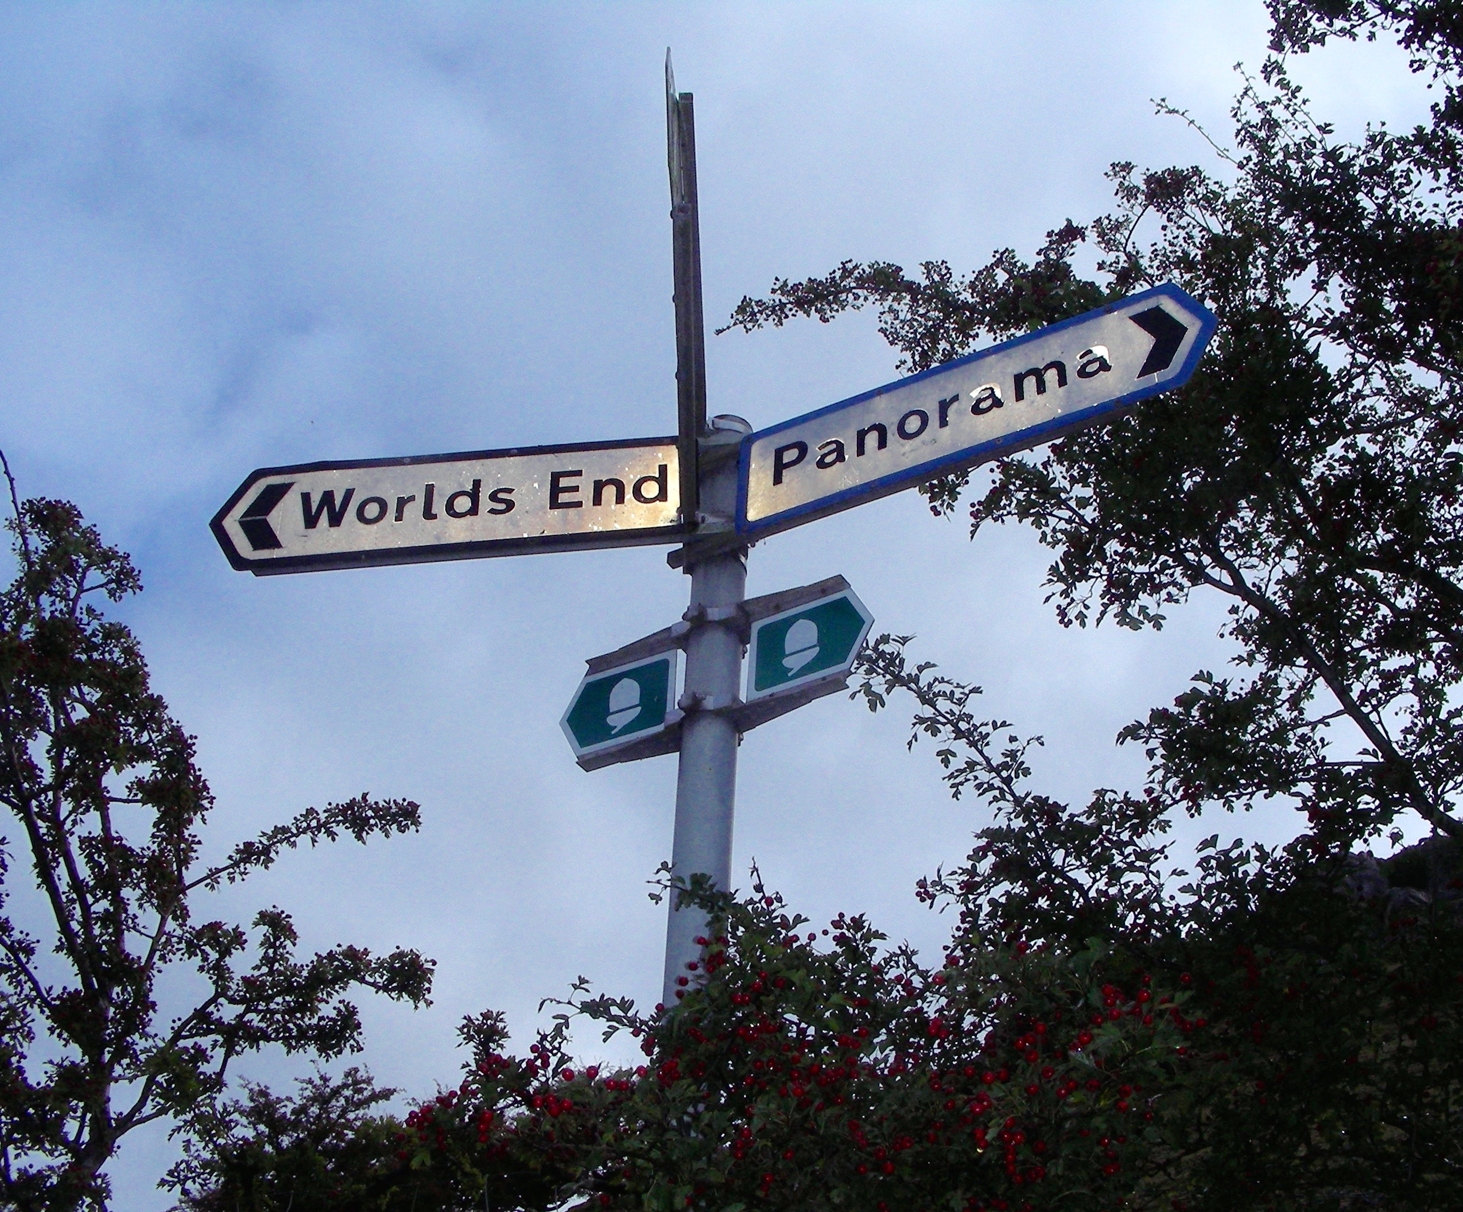
Pandemonium
or
Panorama

Slide 6
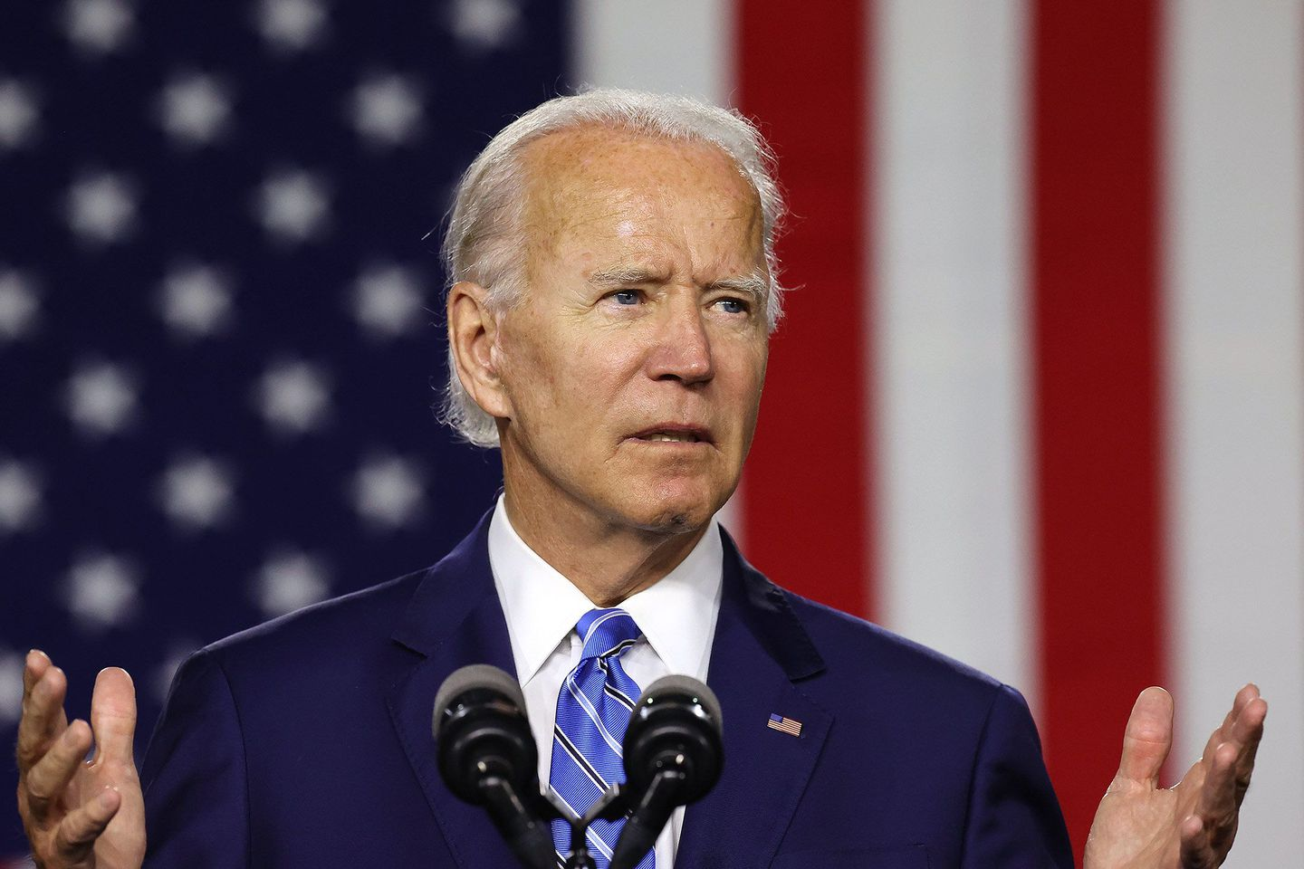

Slide 7
Equity &
Social Mobility

Slide 8
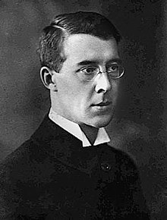

Slide 9
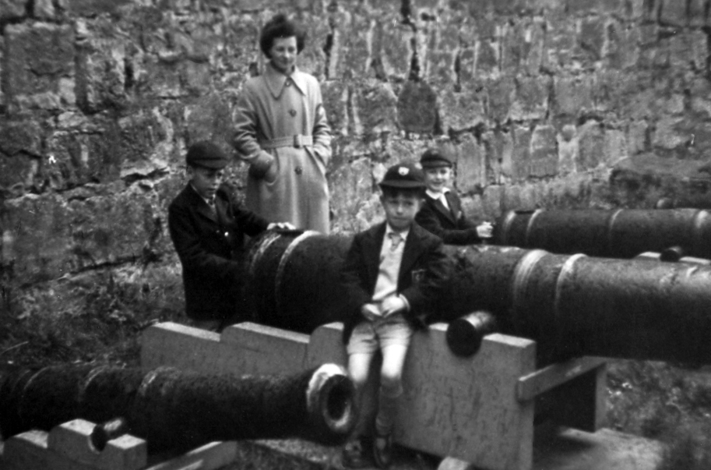

Slide 10
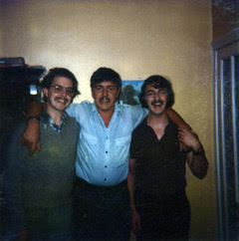

Slide 11
Social mobility is not an alternative to greater equity.
It’s the consequence of greater equity.

Slide 12
Pandemonium | Panorama
Austerity | Prosperity
Blended Technology | Enhancing Technology
Test-Based Accountability | Collective Responsibility

Slide 13
Austerity

Slide 14
Austerity & Growth : two sides of the same debased coin

Slide 19
The old meritocracy becomes the new aristocracy
Tax extreme wealth

Slide 20
Wealth is protected by
Financial deregulation
Tax avoidance
Savings not being invested
Political Lobbying
Tax-subsidized charities
Legacy donations
Changing the subject
.

Slide 21
Prosperity

Slide 22
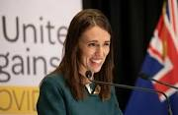
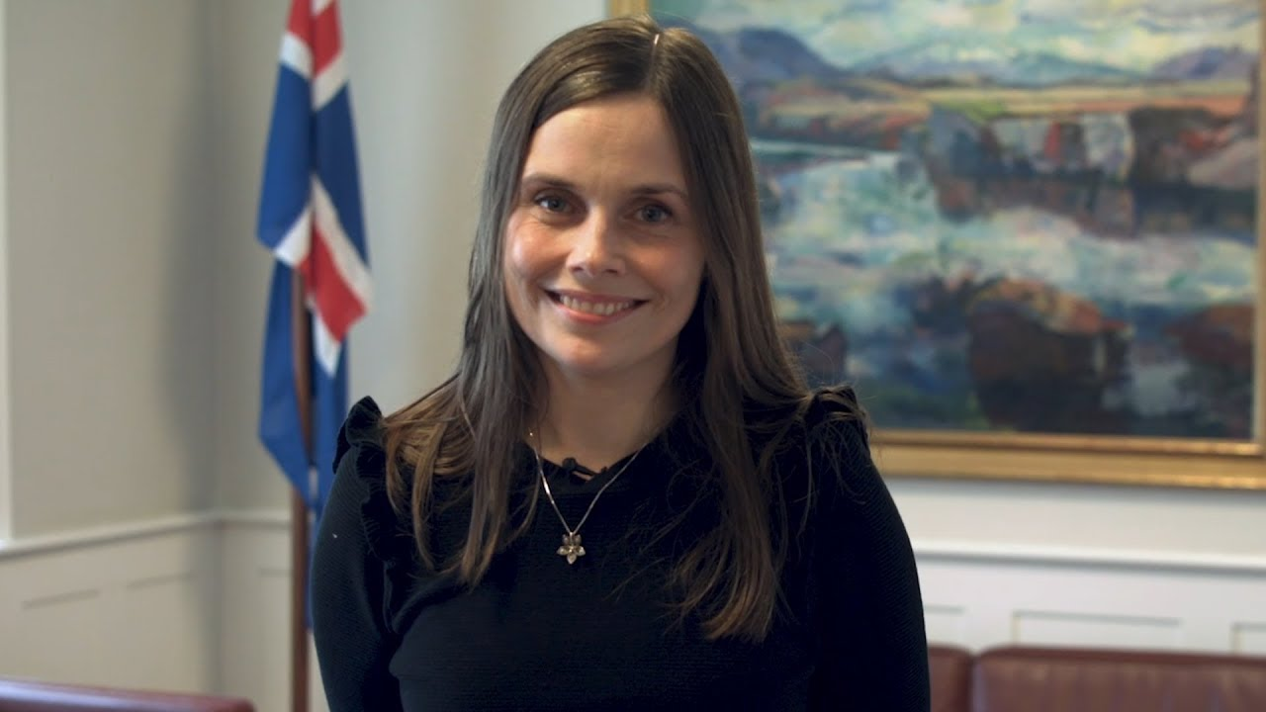
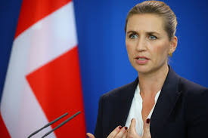
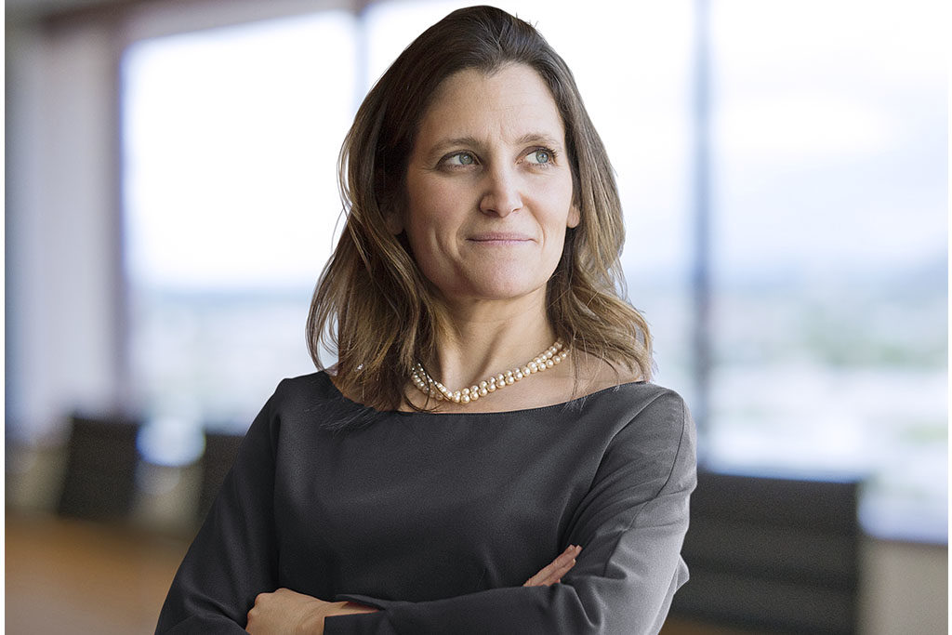
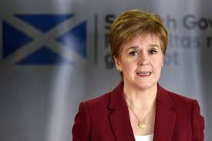
Quality of Life
not just
GDP

Slide 23
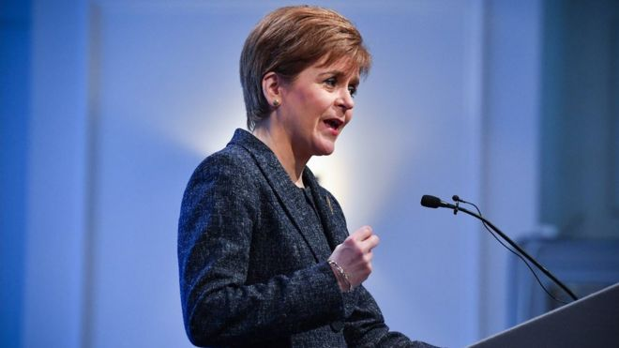
“The goal and objective of all economic policy should be collective wellbeing…
to create a world that considers the quality of a person’s life to be as precious an asset as financial success”
Nicola Sturgeon: First Minister of Scotland

Slide 24
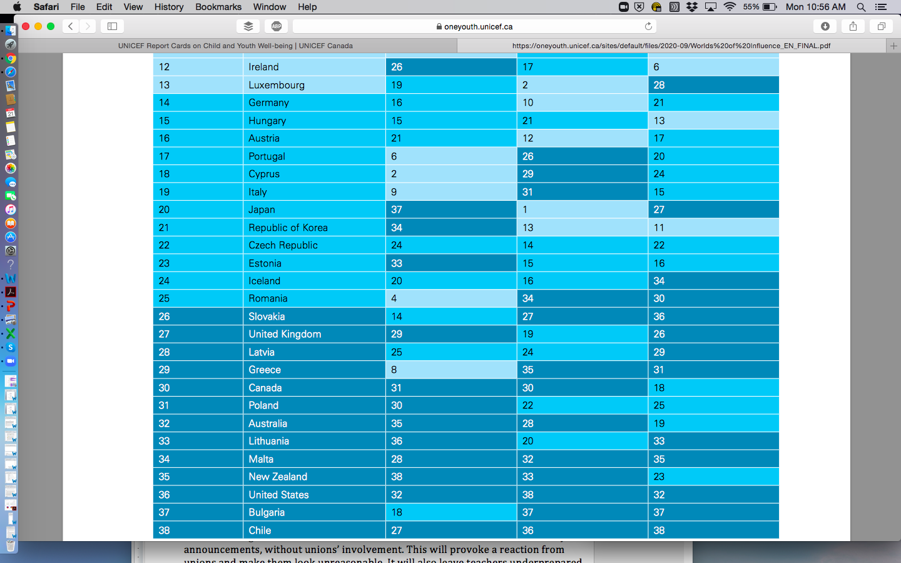

Slide 25
PROSPERITY IN EDUCATIOn
Tax extreme wealth
Invest in public education
Ring-fence public education
Develop high quality vocational education
Teach about wealth & tax avoidance, as well as entrepreneurship & financial management
Make quality of life a key educational outcome.

Slide 26
Austerity
Blended & Hybrid Technology

Slide 27
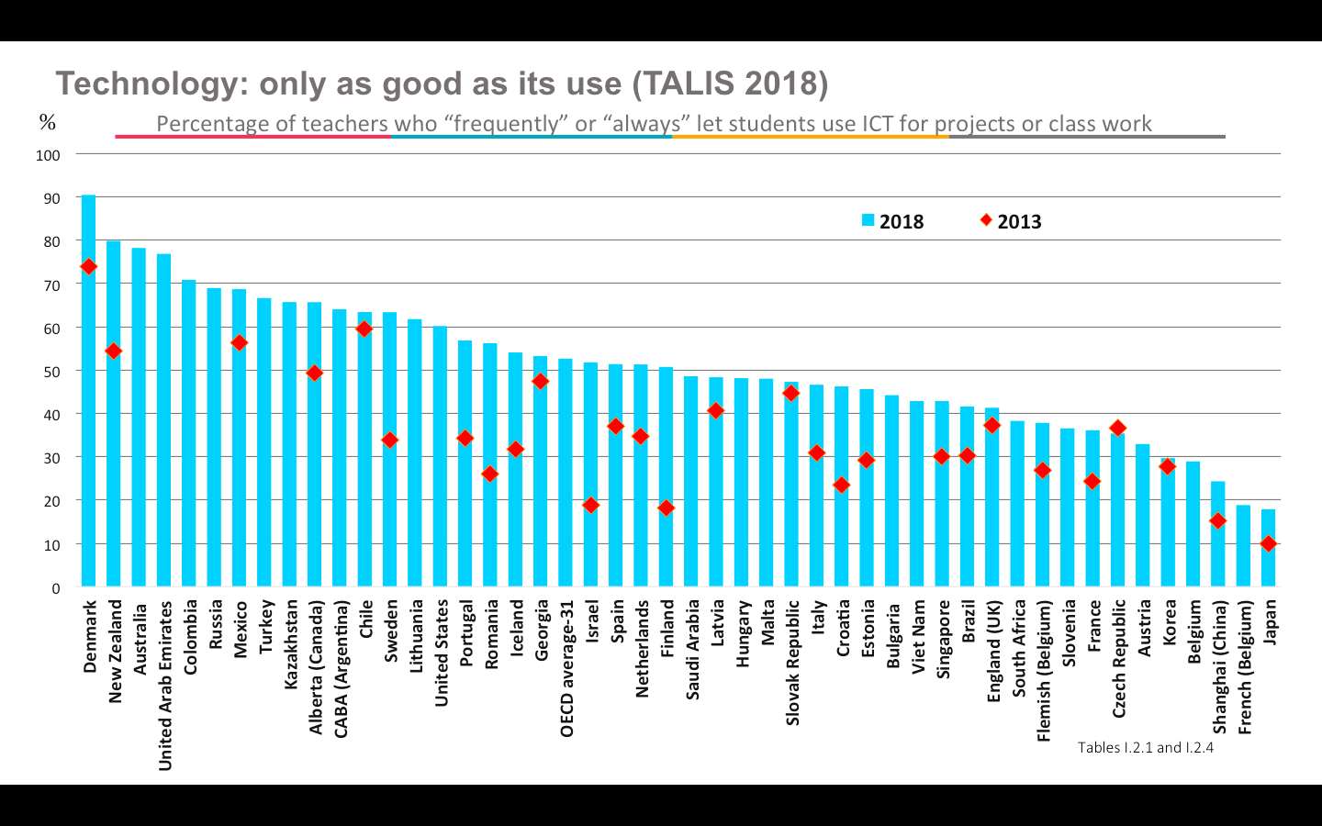

Slide 28
Prosperity
Enhancing Technology

Slide 29
The Primacy of Physical Schools & Teaching
Enhancing Good Teaching
Universal Public Access
Unique Value Proposition
Disciplined Innovation
Risk Reduction
Inclusive Design
Teacher Professionalism
9. Public Responsibility
10. Social Benefit

Slide 30
Thank you
www.andyhargreaves.com
@hargreavesbc

